Slide 1
Binary Search Trees(BST)
CS 225 – Data Structures

Slide 2
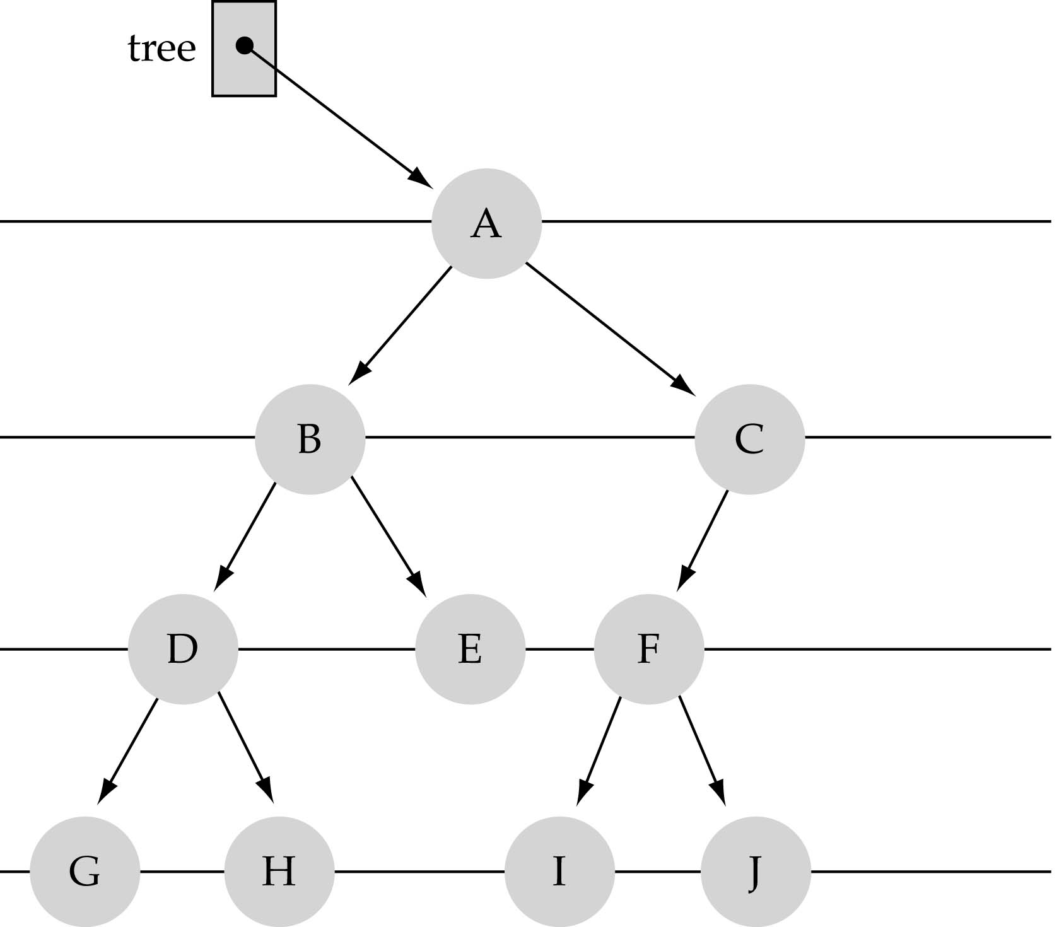
What is a binary tree?
Property 1: each node can have up to two successor nodes.

Slide 3
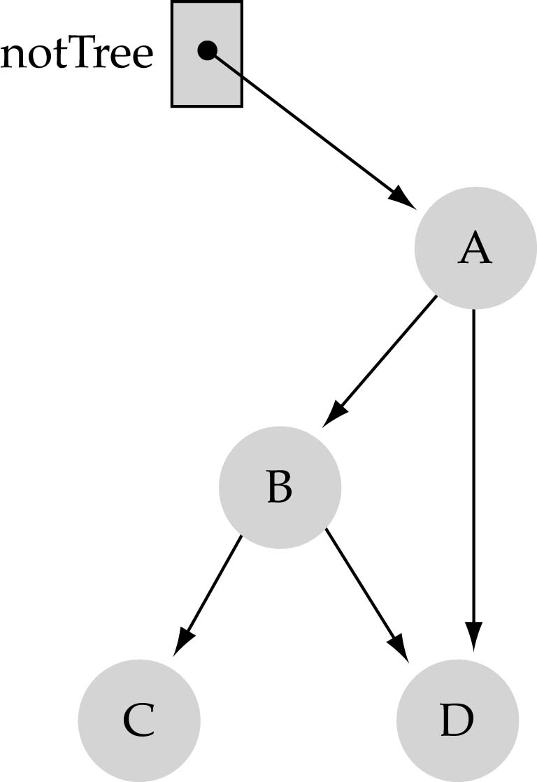
What is a binary tree? (cont.)
Property 2: a unique path exists from the root to every other node
Not a valid binary tree!

Slide 4

How to search a binary tree?
(1) Start at the root
(2) Search the tree level
by level, until you find
the element you are
searching for or you reach
a leaf.
Is this better than searching a linked list?
No → O(N)

Slide 5
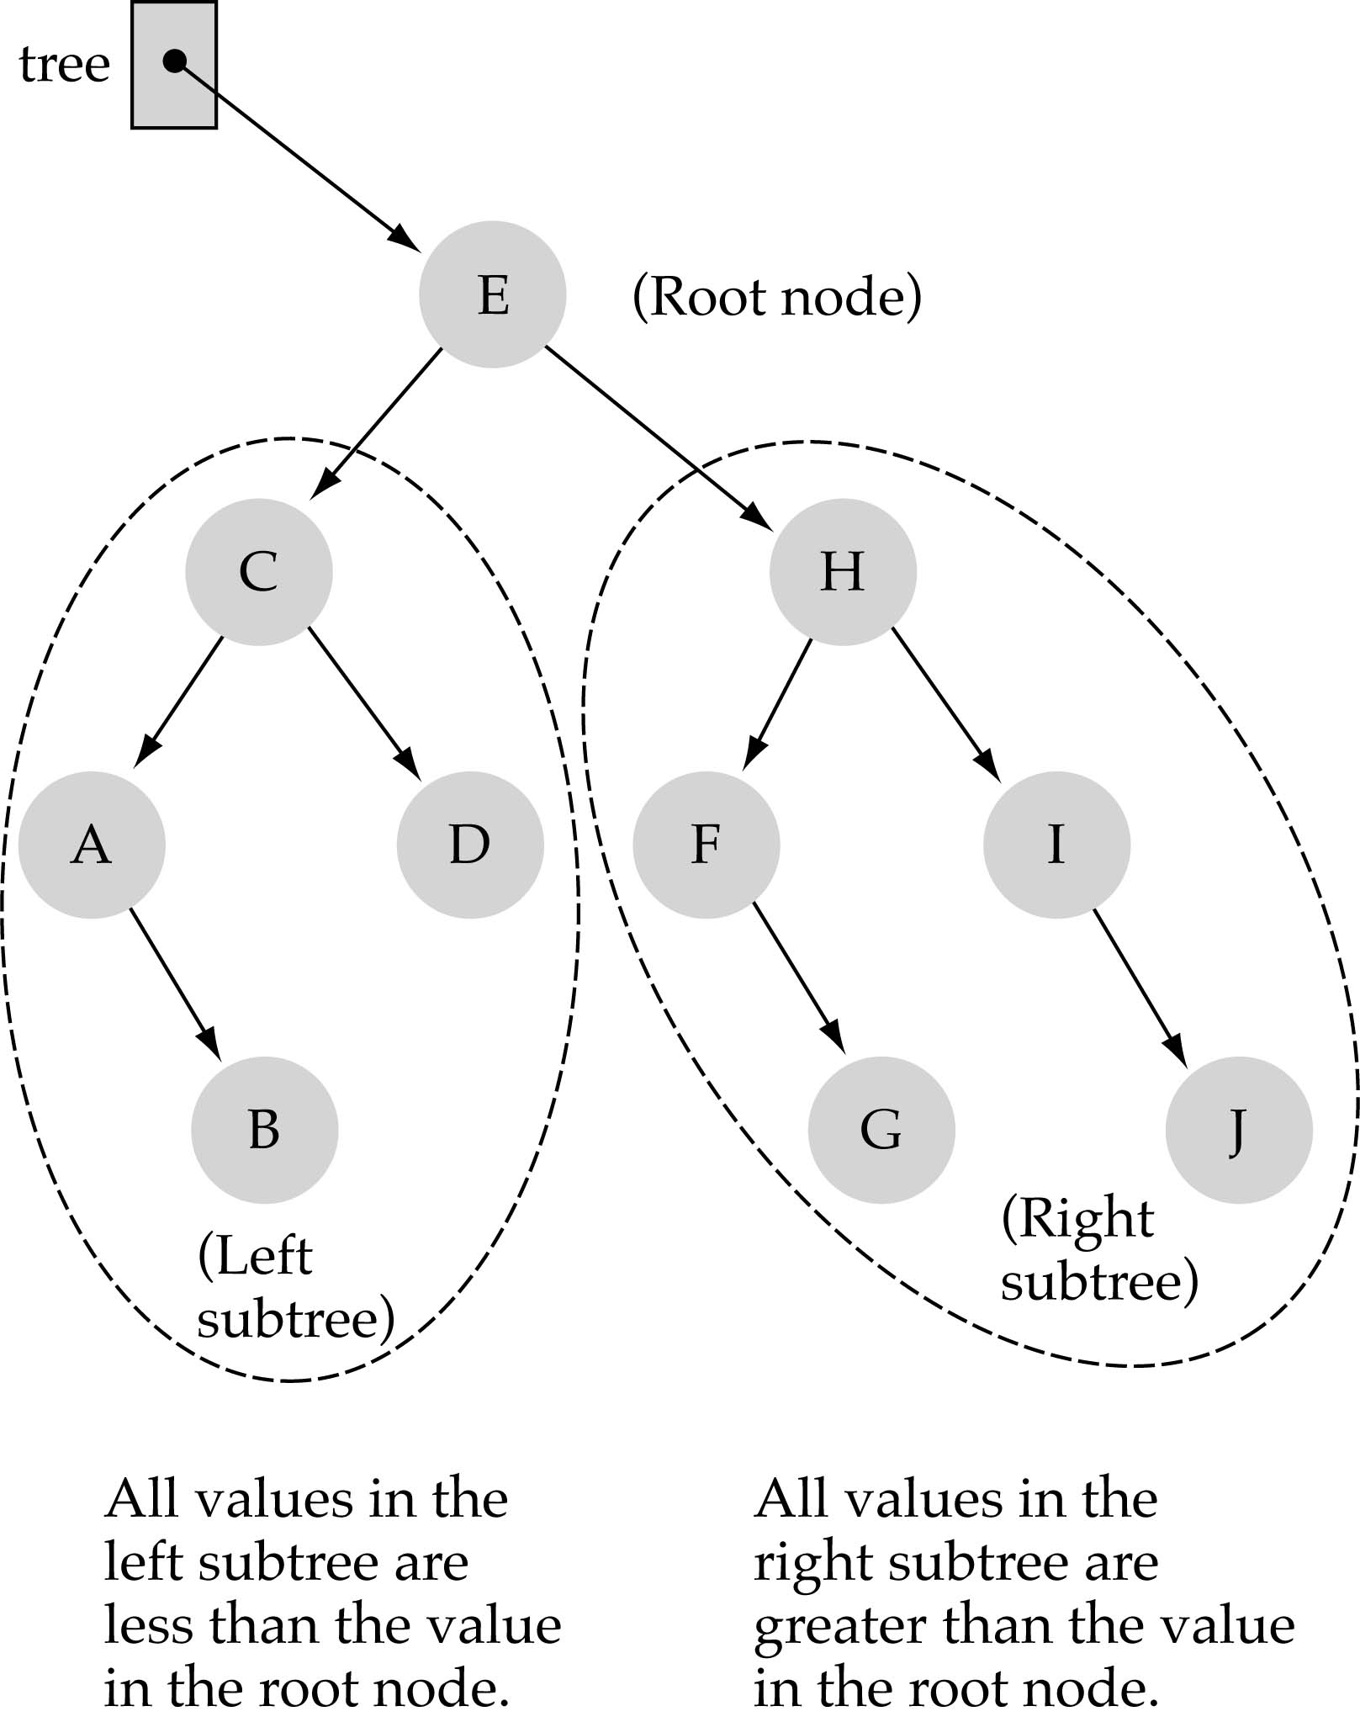
Binary Search Trees (BSTs)
Binary Search Tree Property:
The value stored at
a node is greater than
the value stored at its
left child and less than
the value stored at its
right child

Slide 6
Binary Search Trees (BSTs)
In a BST, the value stored at the root of a subtree is greater than any value in its left subtree and less than any value in its right subtree!

Slide 7
Binary Search Trees (BSTs)
Where is the smallest element?
Ans: leftmost element
Where is the largest element?
Ans: rightmost element

Slide 8
How to search a binary search tree?
(1) Start at the root
(2) Compare the value of the item you are searching for with the value stored at the root
(3) If the values are equal, then item found; otherwise, if it is a leaf node, then not found

Slide 9
How to search a binary search tree?
(4) If it is less than the value stored at the root, then search the left subtree
(5) If it is greater than the value stored at the root, then search the right subtree
(6) Repeat steps 2-6 for the root of the subtree chosen in the previous step 4 or 5

Slide 10
How to search a binary search tree?
Is this better than searching
a linked list?
Yes !! ---> O(logN)

Slide 11
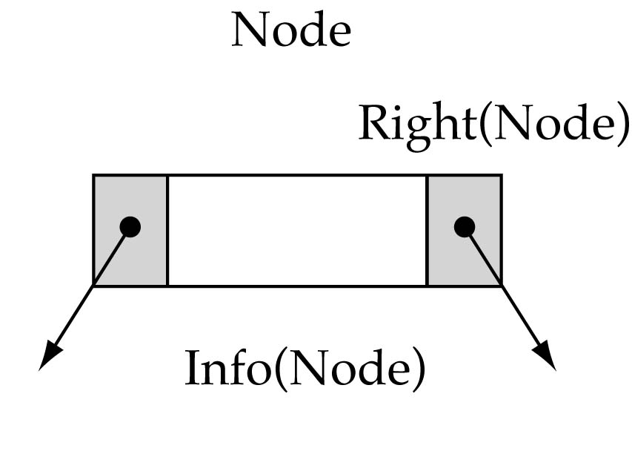
Tree node structure
template<class ItemType>
struct TreeNode<ItemType> {
ItemType info;
TreeNode<ItemType>* left;
TreeNode<ItemType>* right;
};

Slide 12
Binary Search Tree Specification
#include <fstream.h>
struct TreeNode<ItemType>;
enum OrderType {PRE_ORDER, IN_ORDER, POST_ORDER};
template<class ItemType>
class TreeType {
public:
TreeType();
~TreeType();
TreeType(const TreeType<ItemType>&);
void operator=(const TreeType<ItemType>&);
void MakeEmpty();
bool IsEmpty() const;
bool IsFull() const;
int NumberOfNodes() const;

Slide 13
Binary Search Tree Specification
(cont.)
void RetrieveItem(ItemType&, bool& found);
void InsertItem(ItemType);
void DeleteItem(ItemType);
void ResetTree(OrderType);
void GetNextItem(ItemType&, OrderType, bool&);
void PrintTree(ofstream&) const;
private:
TreeNode<ItemType>* root;
};

Slide 14
Function NumberOfNodes
Recursive implementation
#nodes in a tree =
#nodes in left subtree + #nodes in right subtree + 1
What is the size factor?
Number of nodes in the tree we are examining
What is the base case?
The tree is empty
What is the general case?
CountNodes(Left(tree)) + CountNodes(Right(tree)) + 1

Slide 15
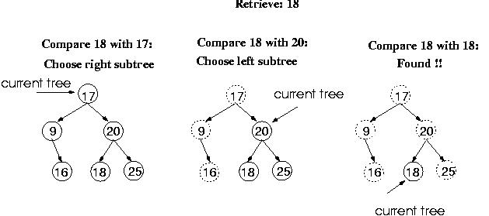
Function RetrieveItem

Slide 16
Function Retrieve Item
What is the size of the problem?
Number of nodes in the tree we are examining
What is the base case(s)?
When the key is found
The tree is empty (key was not found)
What is the general case?
Search in the left or right subtrees

Slide 17
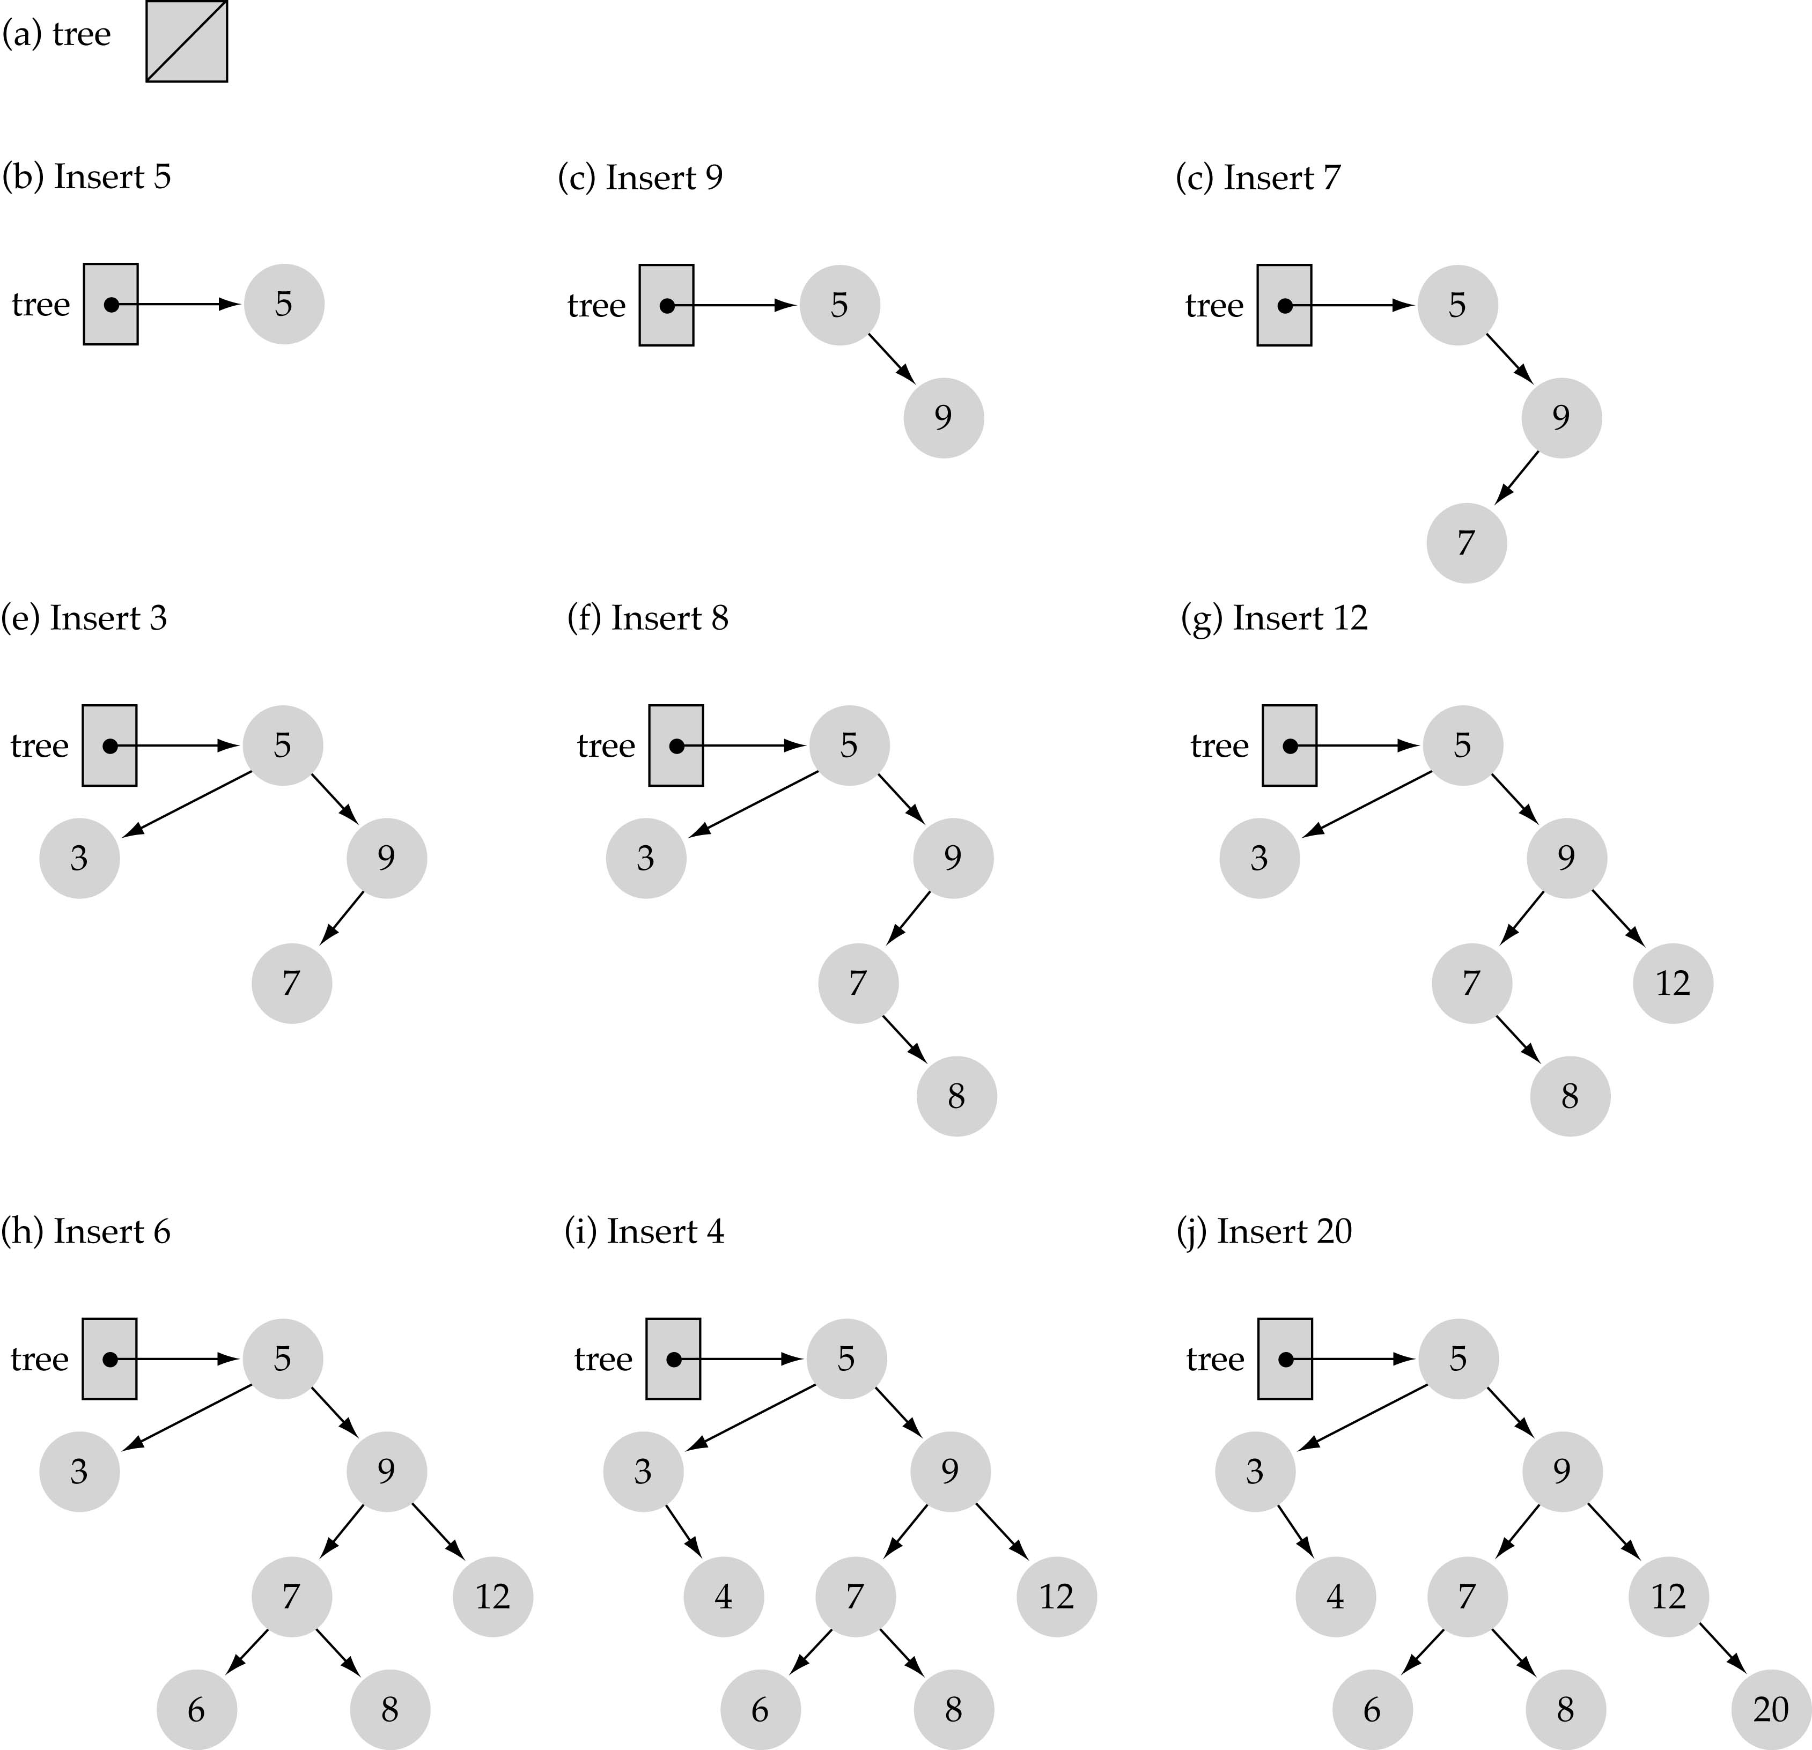
Function InsertItem
Use the binary search tree property to insert the new item at the correct place

Slide 18
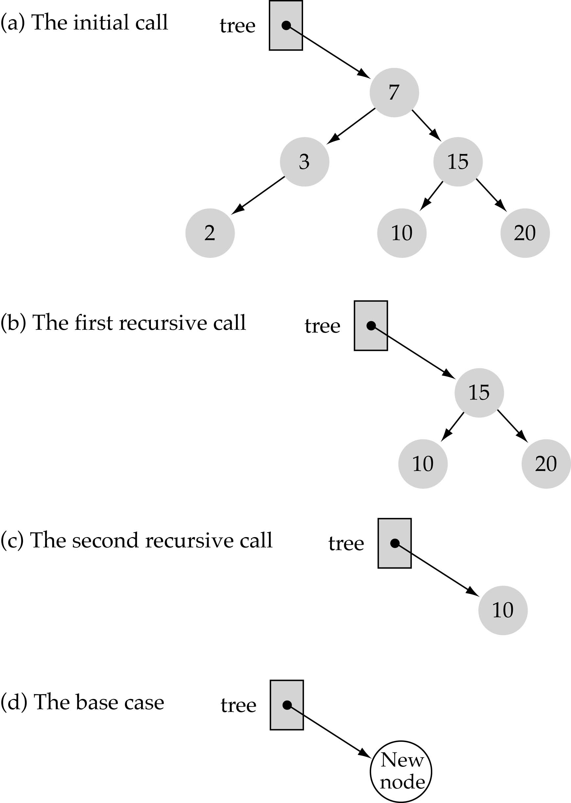
Function InsertItem
(cont.)
Implementing insertion resursively
e.g., insert 11

Slide 19
Function InsertItem (cont.)
What is the size of the problem?
Number of nodes in the tree we are examining
What is the base case(s)?
The tree is empty
What is the general case?
Choose the left or right subtree

Slide 20
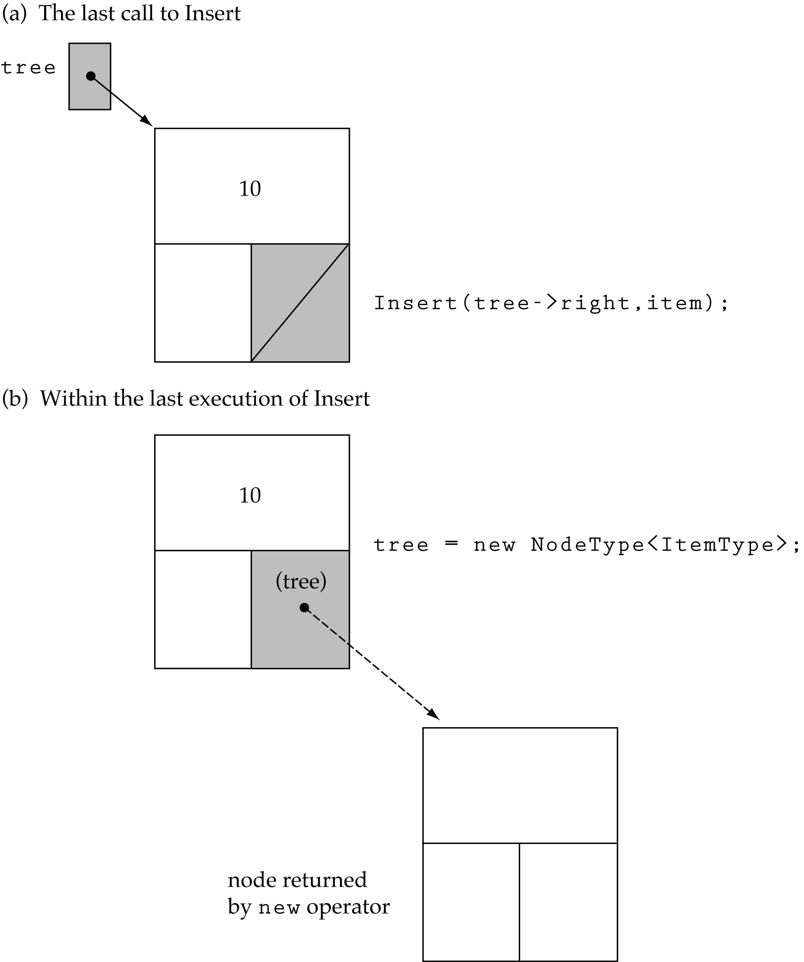
Function InsertItem (cont.)
Insert 11

Slide 21
Does the order of inserting elements into a tree matter?
Yes, certain orders might produce very unbalanced trees!

Slide 22
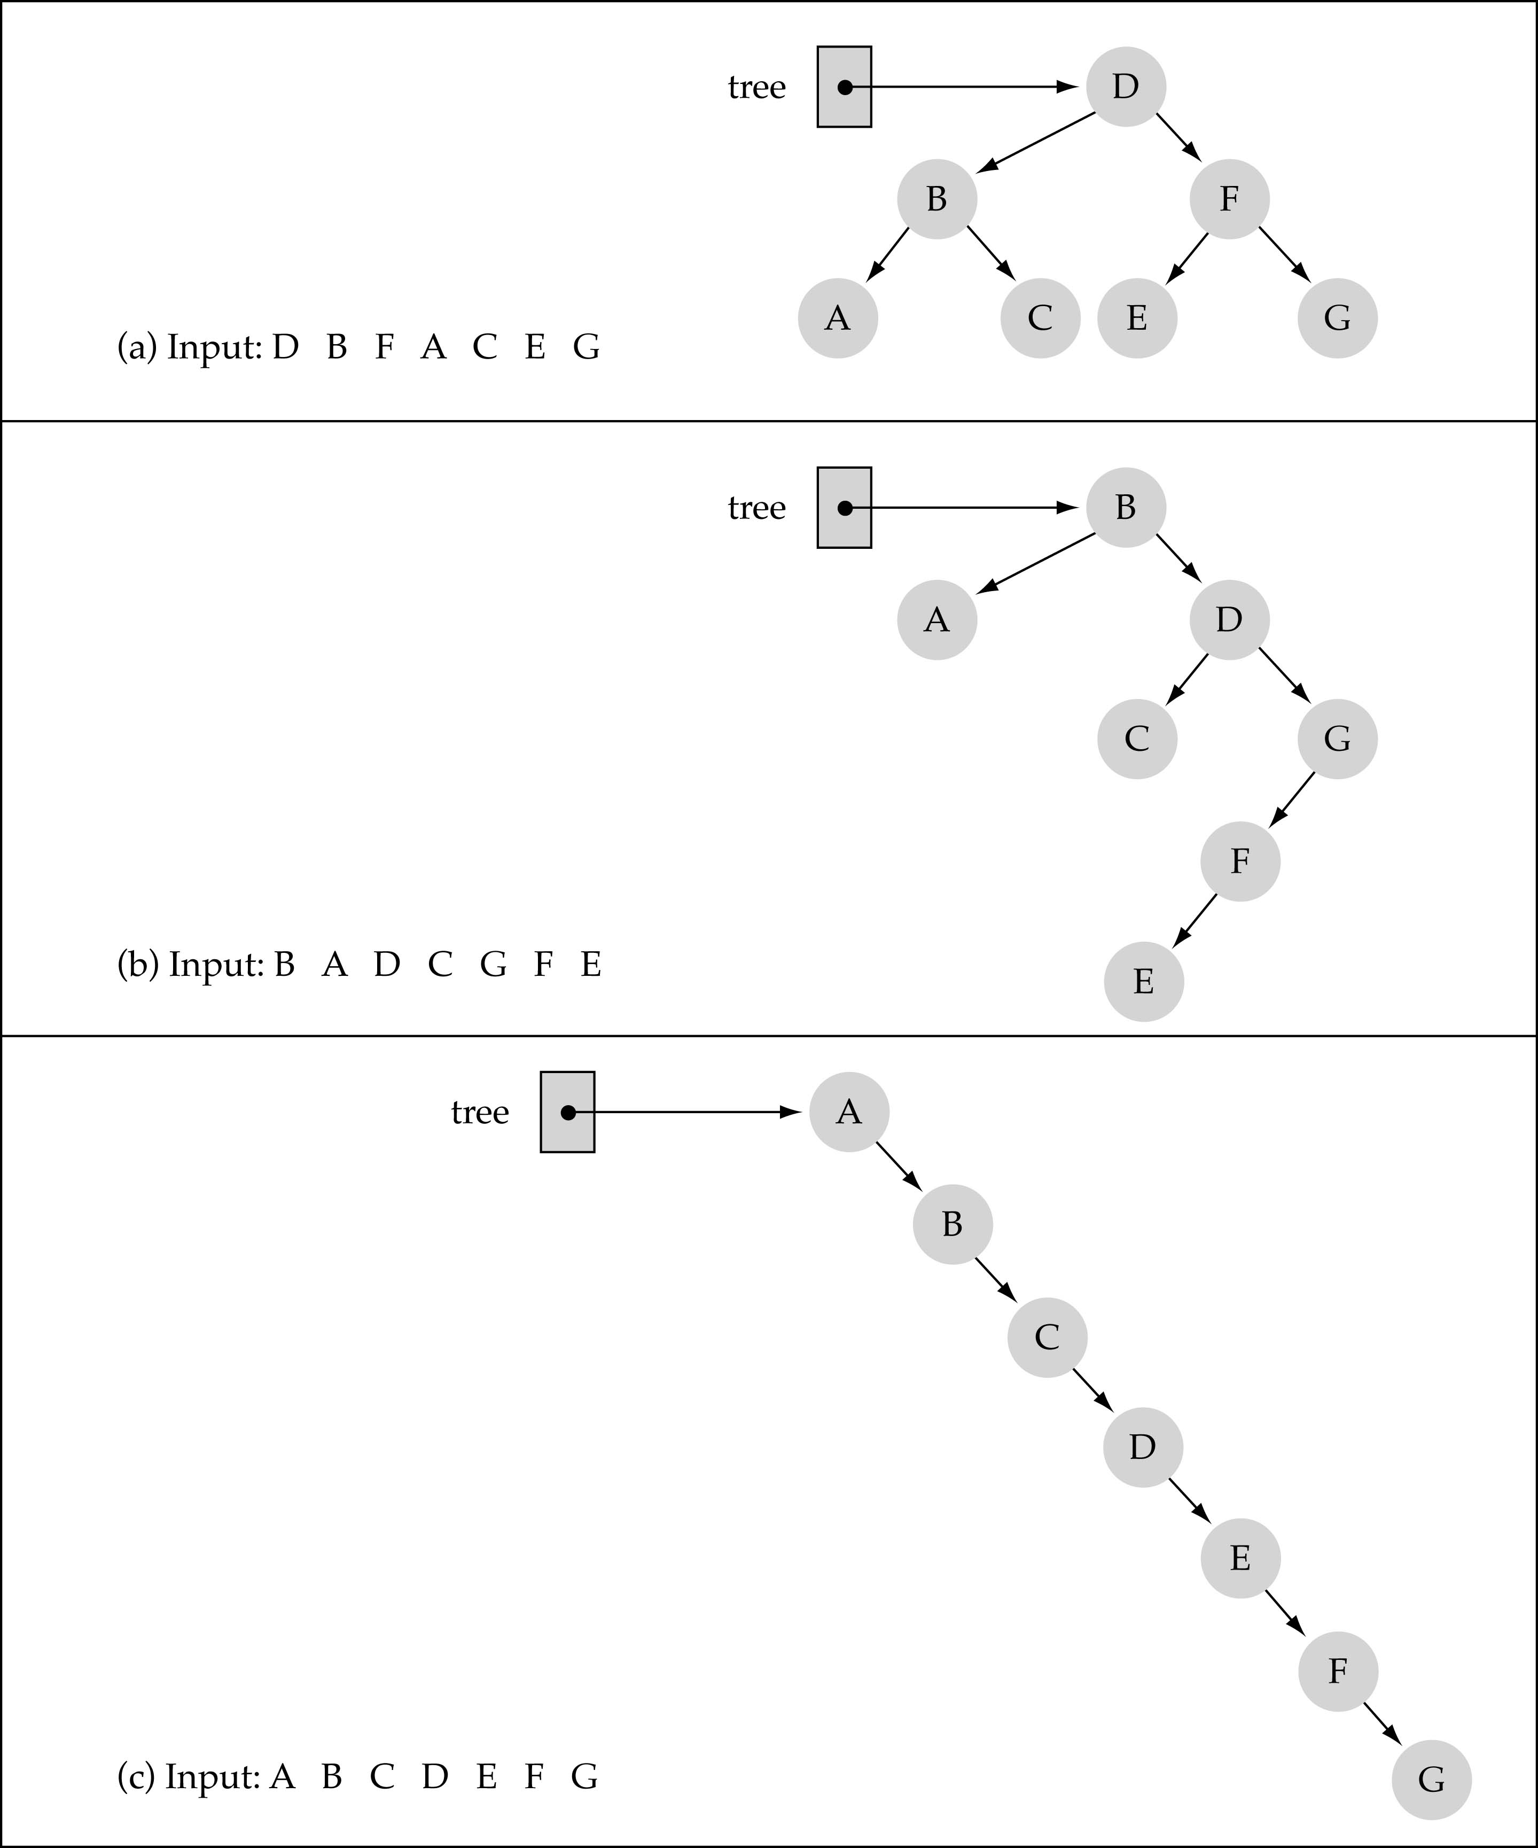
Does the order of inserting elements into a tree matter?
(cont.)

Slide 23
Does the order of inserting elements into a tree matter? (cont’d)
Unbalanced trees are not desirable because search time increases!
Advanced tree structures, such as red-black trees, guarantee balanced trees.

Slide 24
Function Delete Item
First, find the item; then, delete it
Binary search tree property must be preserved!!
We need to consider three different cases:
(1) Deleting a leaf
(2) Deleting a node with only one child
(3) Deleting a node with two children

Slide 25
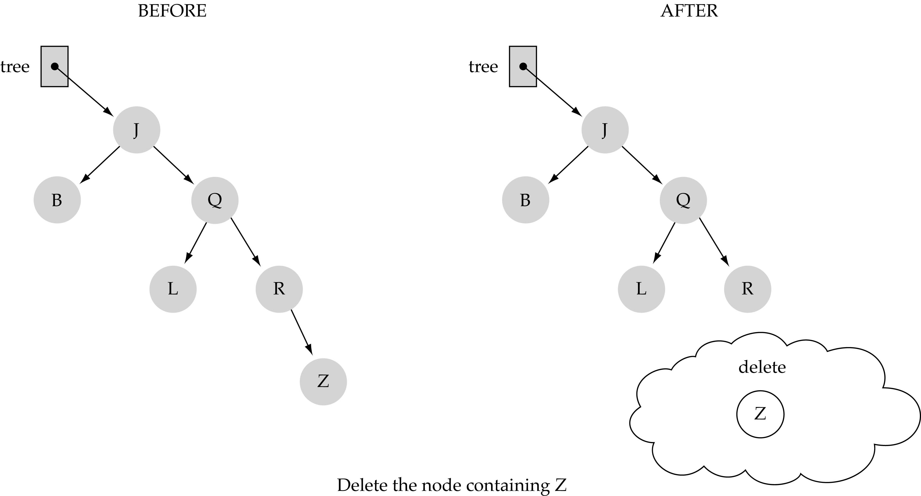
(1) Deleting a leaf

Slide 26
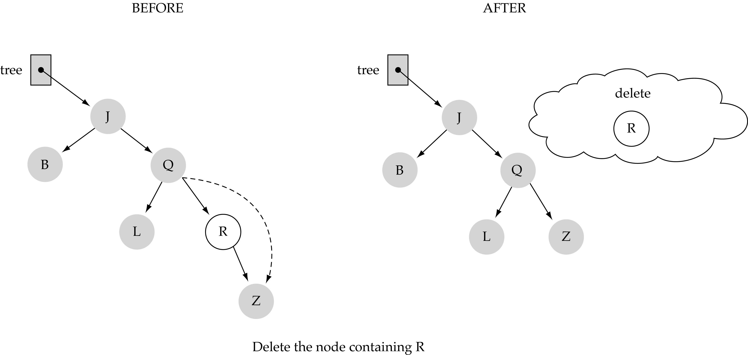
(2) Deleting a node with only one child

Slide 27
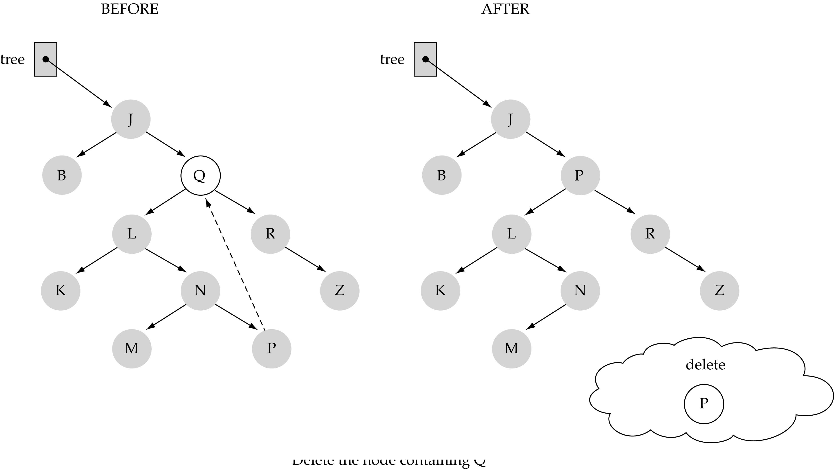
(3) Deleting a node with two children

Slide 28
(3) Deleting a node with two children (cont.)
Find predecessor (i.e., rightmost node in the left subtree)
Replace the data of the node to be deleted with predecessor's data
Delete predecessor node

Slide 29
Function DeleteItem (cont.)
What is the size of the problem?
Number of nodes in the tree we are examining
What is the base case(s)?
Key to be deleted was found
What is the general case?
Choose the left or right subtree

Slide 30
Binary search tree (BST)
Binary search tree (BST) is a node-based binary tree data structure which has the following properties:
The left sub tree of a node contains only nodes with keys less than the root node's key.
The right sub-tree of a node contains only nodes with keys greater than the root node's key.
Both the left and right sub-trees must also be binary search trees.

Slide 31
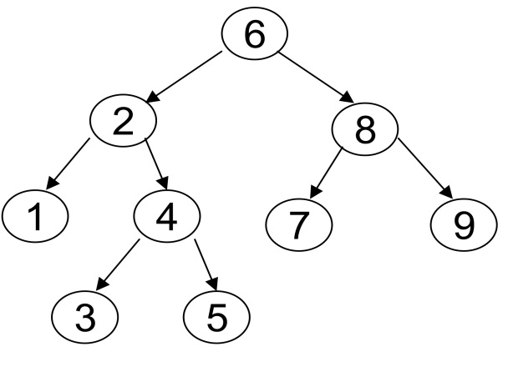
BST
From the above properties it naturally follows that:

Slide 32
Program: Creating a Binary Search Tree
We assume that every node of a binary search tree is capable of holding an integer data item and that the links can be made to point to the root of the left subtree and the right subtree, respectively. Therefore, the structure of the node can be defined using the following declaration:

Slide 33
Operation on BST
OPERATIONS
Operations on a binary tree require comparisons between nodes.
These comparisons are made with calls to a comparator, which is a subroutine that computes the total order (linear order) on any two values.
This comparator can be explicitly or implicitly defined, depending on the language in which the BST is implemented.
The following are the operations that are being done in Binary Tree
Searching.
Sorting.
Deletion.
Insertion.

Slide 34
Applications of Trees
1. Compiler Design.
2. Unix / Linux.
Database Management.
dynamic dictionary
4. Trees are very important data structures in computing.
5. They are suitable for:
a. Hierarchical structure representation, e.g.,
i. File directory.
ii. Organizational structure of an institution.
iii. Class inheritance tree.
b. Problem representation, e.g.,
i. Expression tree.
ii. Decision tree.
C. Efficient algorithmic solutions, e.g.,
i. Search trees.
ii. Efficient priority queues via heaps.

Slide 35
struct node
{
int info;
struct node *left;
struct node *right;
}*root;
class BST
{
public:
void find(int, node **, node **);
void insert(node *, int);
void preorder(node *);
void inorder(node *);
void postorder(node *);
void display(node *, int);
BST();
};

